Slide 1



UNIT 4; Every man is an artist
Almost Unknown

Slide 2
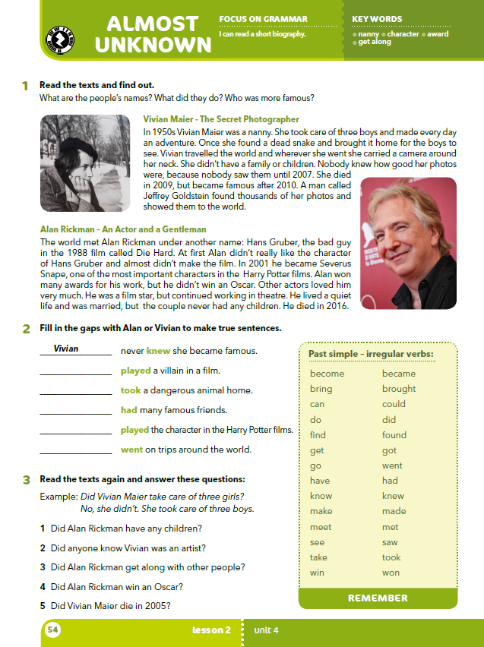
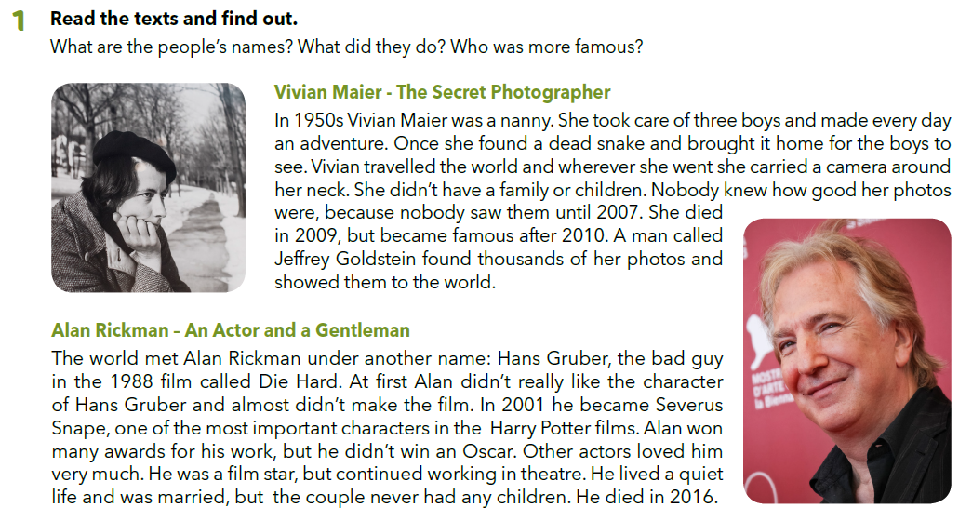
How many famous artists can you name?
Do you know more musicians or actors / painters or sculptors / dancers or composers?
How much do you know about your favourite artist?
Read the texts and find out.
What are the people’s names?
What did they do?
Who was more famous?

Slide 3
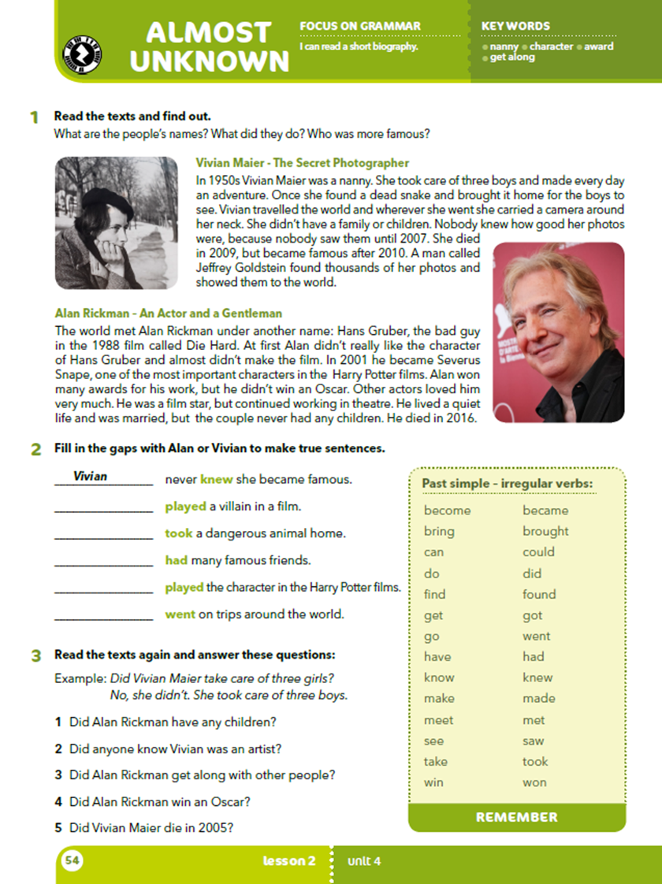
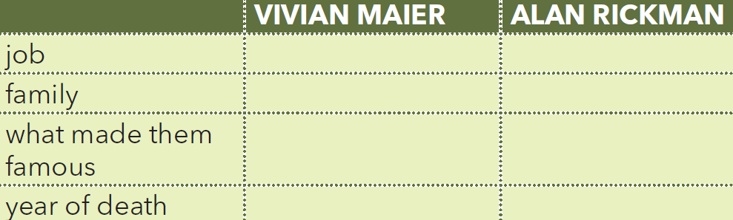
Read the text once again and fill in the table.
nanny / photographer

Slide 4
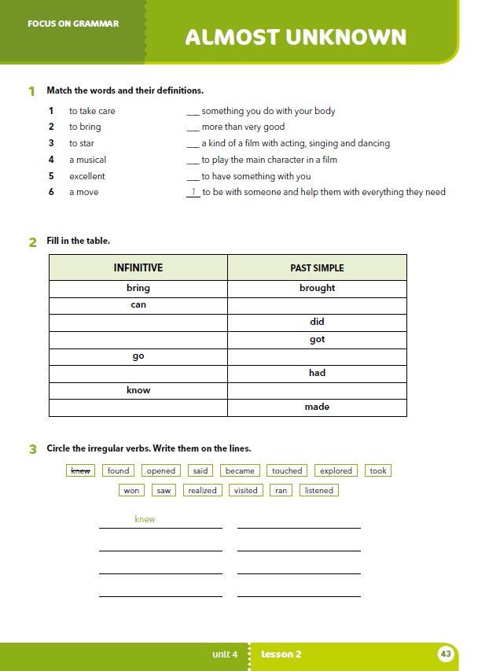
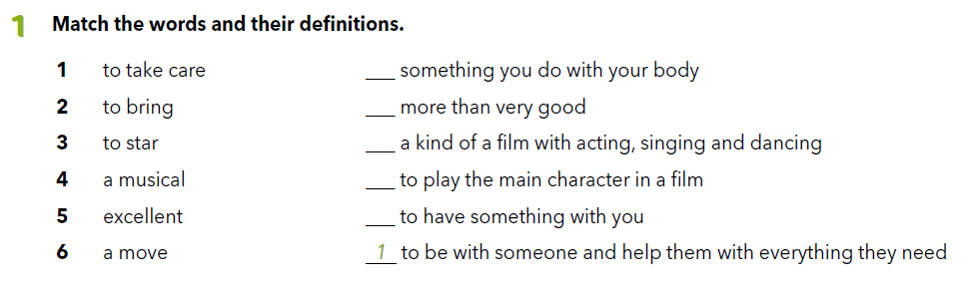
Workbook, p. 43
6
5
4
3
2

Slide 5

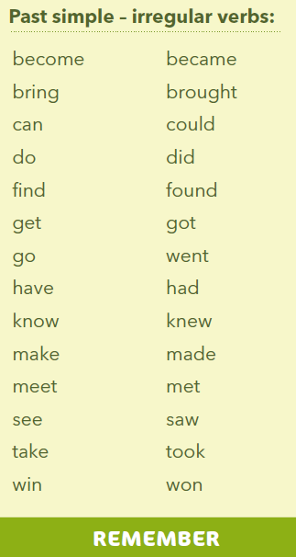
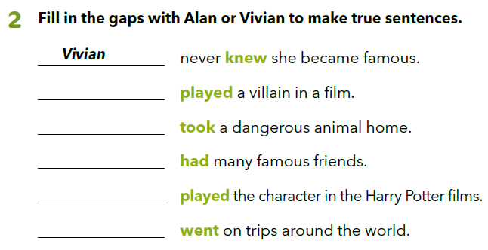
Alan
Vivian
Alan
Alan
Vivian

Slide 6
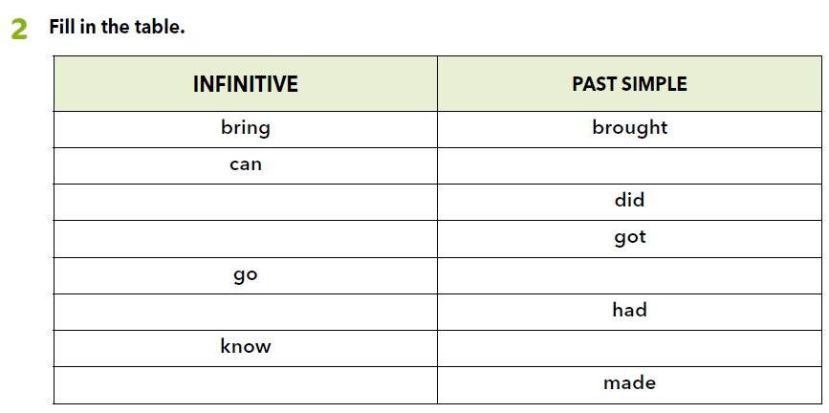
Wokbook, p. 43
could
do
get
went
have
knew
make

Slide 7
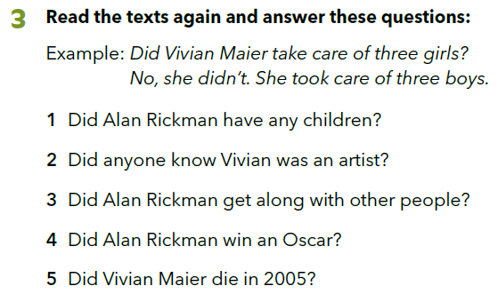
1 No, he didn't. He was married, but he never had any children.
2 No, they didn't. Nobody knew that she was an artist.
3 Yes, he did. Other actors loved him very much.
4 No, he didn't. He won many awards, but he didn't win an Oscar.
5 No, she didn't. She died in 2009.
Complete the text: https://learningapps.org/watch?v=p51e2yhoj20

Slide 8
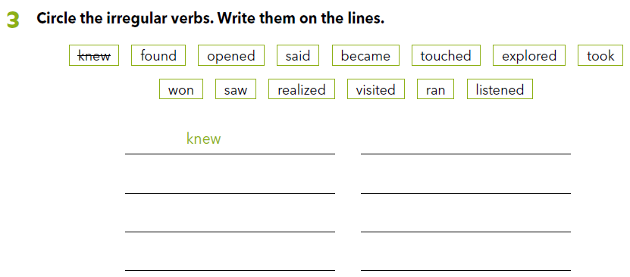

Worbook, p. 43
found

Slide 9
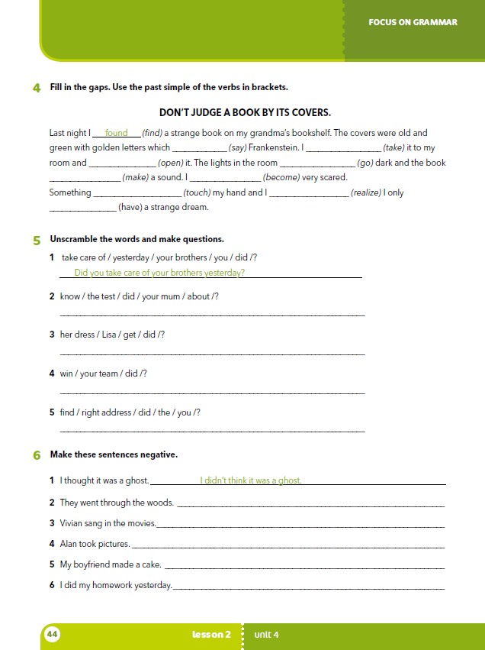
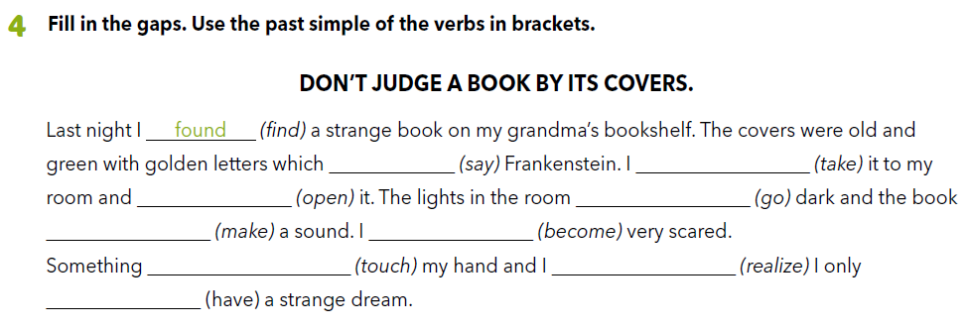
said
took
opened
went
made
became
touched
realized
had

Slide 10
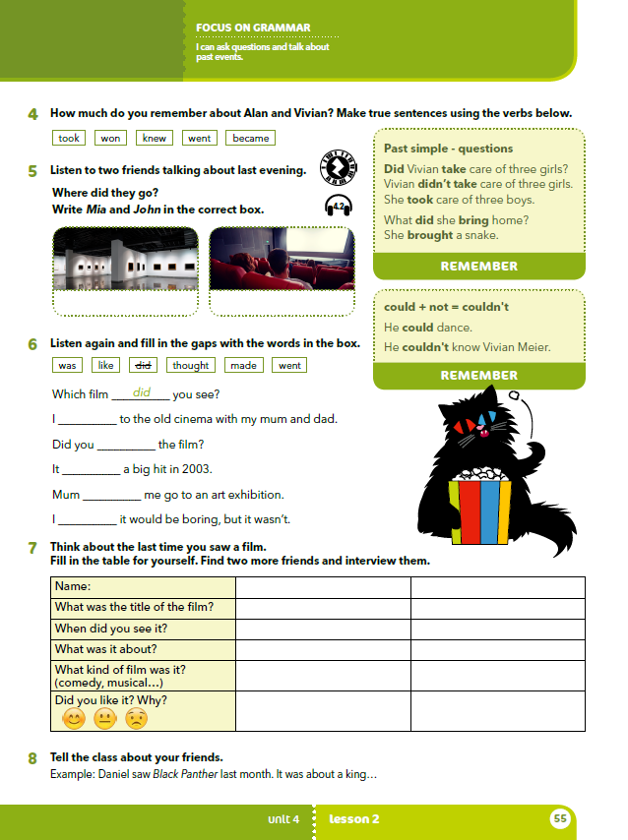
Vivian Maier took care of three boys.
Alan Rickman won many awards for his work.
Vivian Maier never knew she became famous.
Wherever she went, Vivian carried a camera around her neck.
Vivian became famous after 2010.

Slide 11

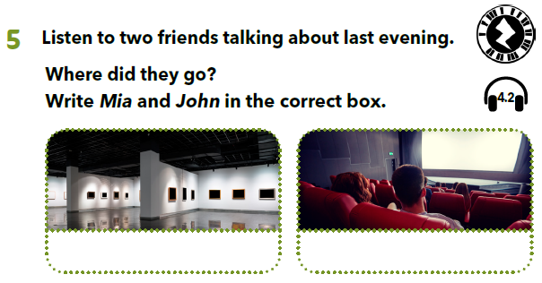

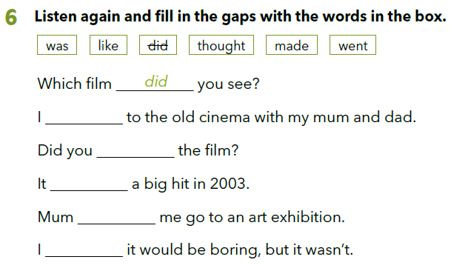
Listen to two friends talking about last evening.
https://www.e-sfera.hr/dodatni-digitalni-sadrzaji/5f0139a0-2910-4a8f-be1a-b312679d64c8/assets/audio/18__unit_04_lesson_2_-_two_friends_talking_1.mp3
John
Mia
Listen again and fill in the gaps with the words in the box. https://www.e-sfera.hr/dodatni-digitalni-sadrzaji/5f0139a0-2910-4a8f-be1a-b312679d64c8/assets/audio/18__unit_04_lesson_2_-_two_friends_talking_1.mp3
went
like
was
made
thought

Slide 12
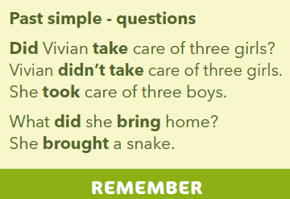
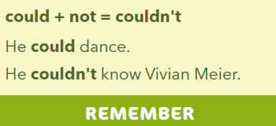

Slide 13

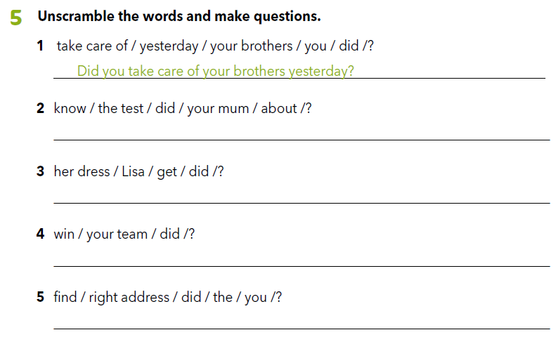
Worbook, p. 44
Did your mum know about the test?
Did Lisa get her dress?
Did your team win?
Did you find the right address?

Slide 14

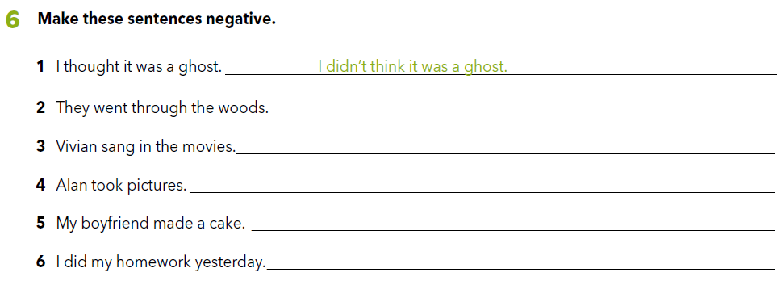
They didn’t go through the woods.
Vivian didn’t sing in the movies.
Alan didn’t take pictures.
My boyfriend didn’t make a cake.
I didn’t do my homework yesterday.

Slide 15
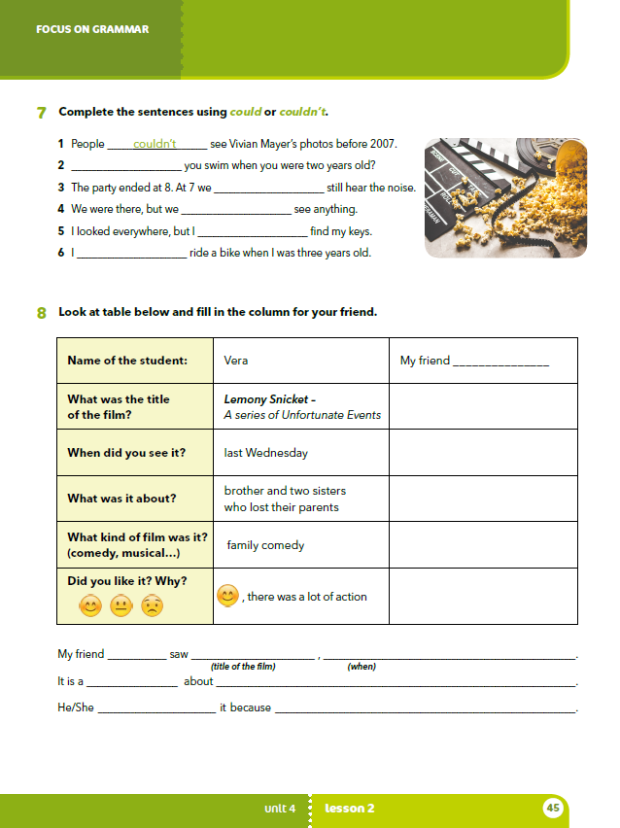
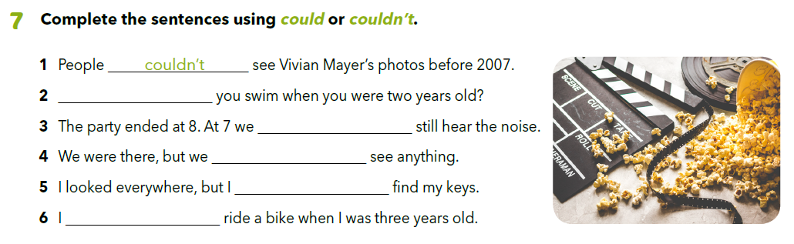
Could
could
couldn’t
couldn’t
could/couldn’t

Slide 16
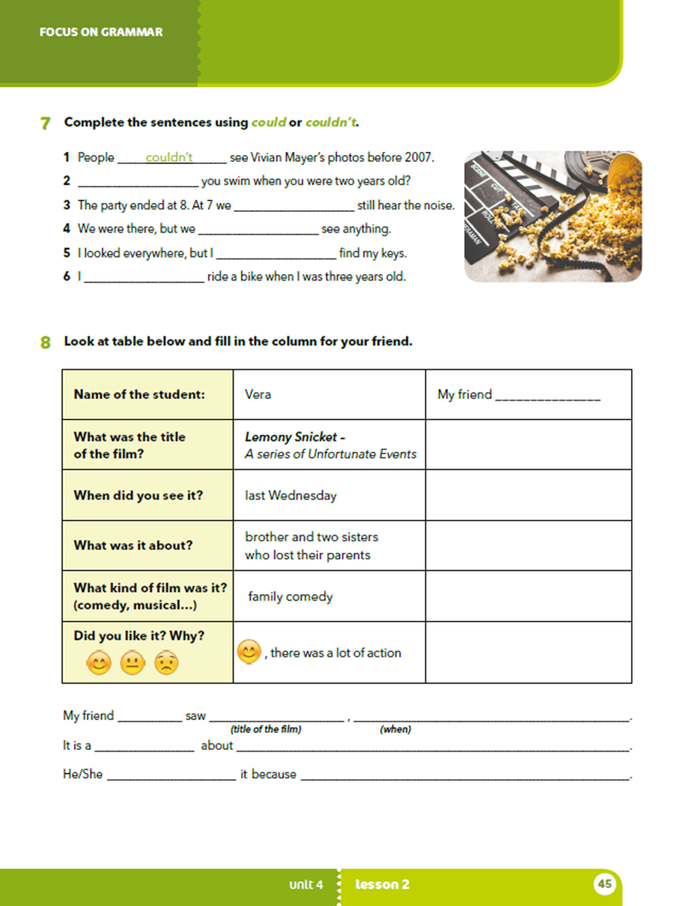
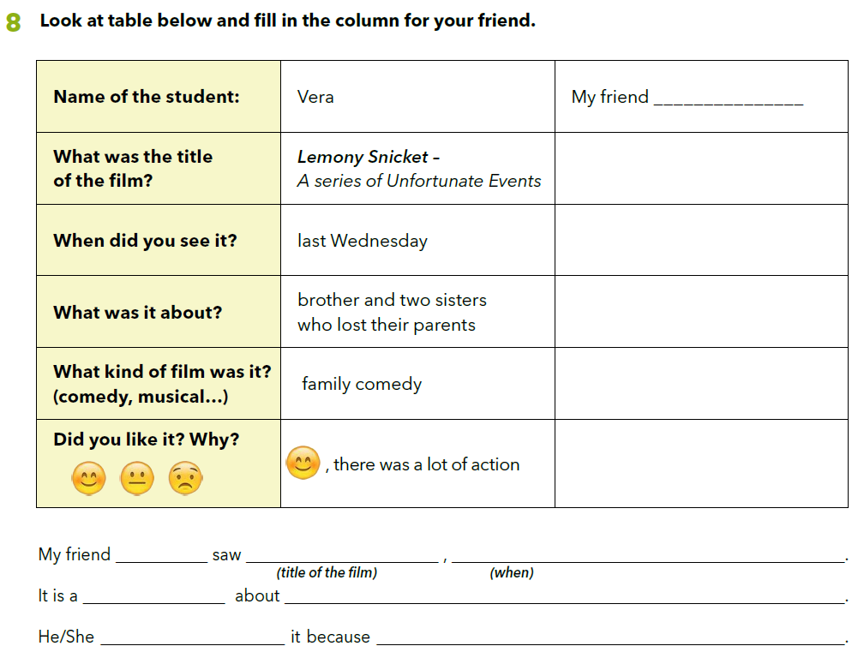

Slide 17

LEARN MORE
https://www.e-sfera.hr/dodatni-digitalni-sadrzaji/5f0139a0-2910-4a8f-be1a-b312679d64c8/
A Top-Secret Artist: Banksy

